Slide 1

CSS (Cascading Style Sheets)
Luis Daniel A. Pambid

Slide 2
Learning Objectives
To develop an understanding of how CSS can enhance the design of a web page
To know the basics of CSS
To create and apply CSS styling to a webpage

Slide 3
Outline
Introduction
Syntax
Selectors
How To Add CSS
Comments
Colors
Backgrounds
Fonts
Text
Margins
Padding
Box Model
Borders

Slide 4
CSS Introduction

Slide 5


Slide 6
What is CSS
CSS is used to control the style of a web document in a simple and easy way.
CSS is the acronym for "Cascading Style Sheet".

Slide 7
Why to Learn CSS?
Cascading Style Sheets, fondly referred to as CSS, is a simple design language intended to simplify the process of making web pages presentable.
CSS is a MUST for students and working professionals to become a great Software Engineer specially when they are working in Web Development Domain. I will list down some of the key advantages of learning CSS:
Create Stunning Web site
Become a web designer
Control web
Learn other languages

Slide 8
Applications of CSS
As mentioned before, CSS is one of the most widely used style language over the web. I'm going to list few of them here:
CSS saves time
Pages load faster
Easy maintenance
Superior styles to HTML
Multiple Device Compatibility
Global web standards

Slide 9
Prerequisites
You should be familiar with:
Basic word processing using any text editor.
How to create directories and files.
How to navigate through different directories.
Internet browsing using popular browsers like Internet Explorer or Firefox.
Developing simple Web Pages using HTML or XHTML.

Slide 10
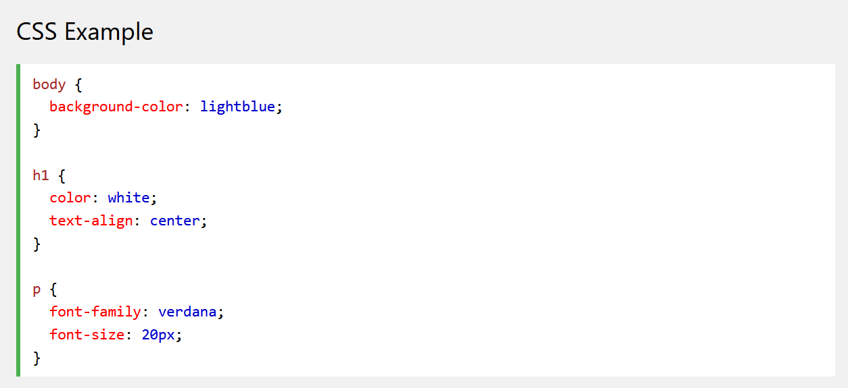
HTML has designs also. Why use CSS?
CSS is used to define styles for your web pages, including the design, layout and variations in display for different devices and screen sizes

Slide 11
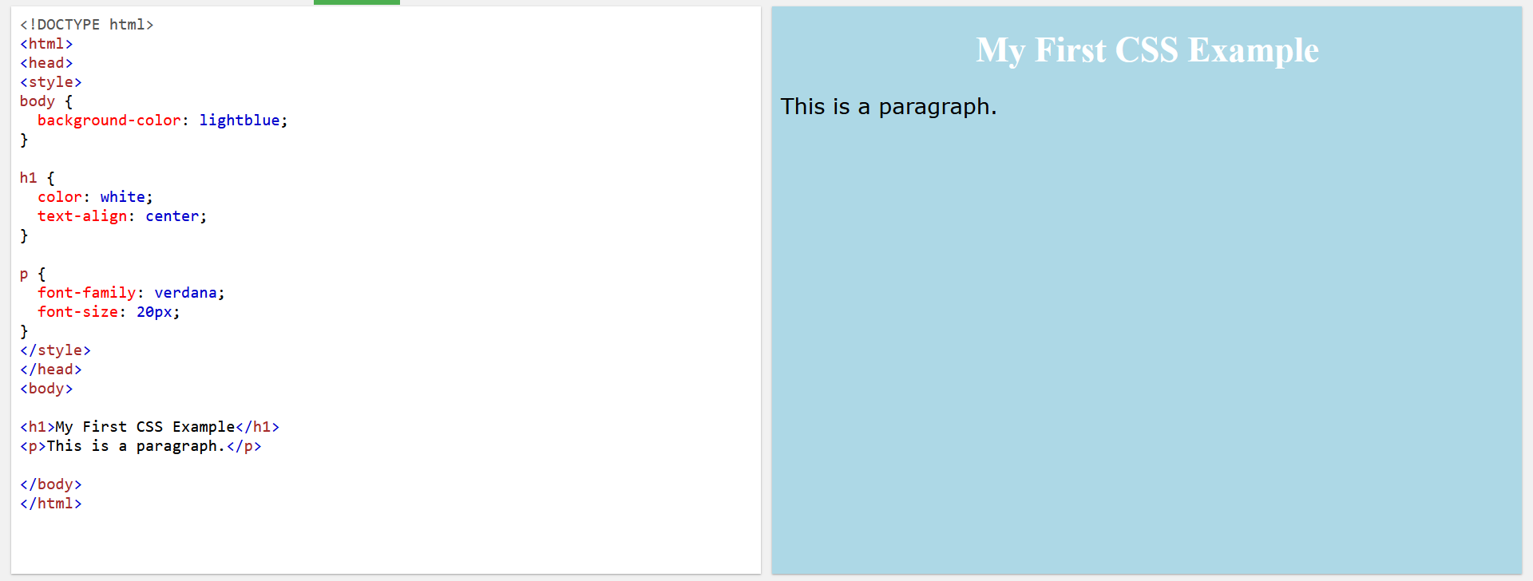

Slide 12
HTML has designs also. Why use CSS? (cont.)
It has more features than HTML specifically in designing
It solves the problem for HTML where:
“When tags like <font>, and color attributes were added to the HTML 3.2 specification, it started a nightmare for web developers. Development of large websites, where fonts and color information were added to every single page, became a long and expensive process.”
HTML was NEVER intended to contain tags for formatting a web page!
CSS removed the style formatting from the HTML page!

Slide 13
HTML has designs also. Why use CSS? (cont.)
CSS Saves a Lot of Work!
The style definitions are normally saved in external .css files.
With an external stylesheet file, you can change the look of an entire website by changing just one file!

Slide 14
CSS Syntax

Slide 15
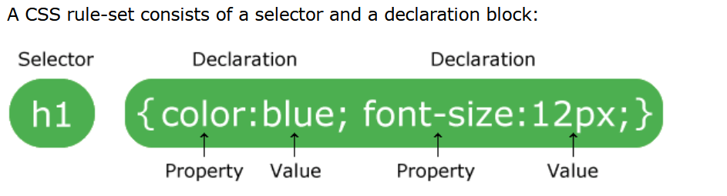
CSS Syntax

Slide 16
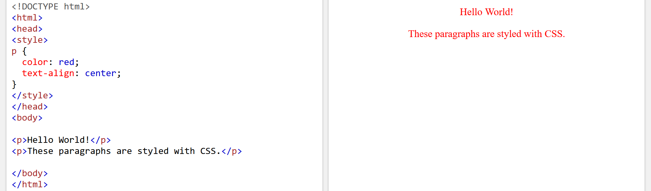
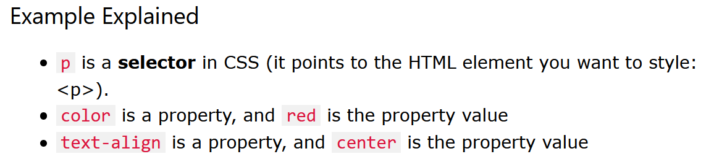

Slide 17
CSS Selectors

Slide 18
CSS Selectors
CSS selectors are used to "find" (or select) the HTML elements you want to style.

Slide 19
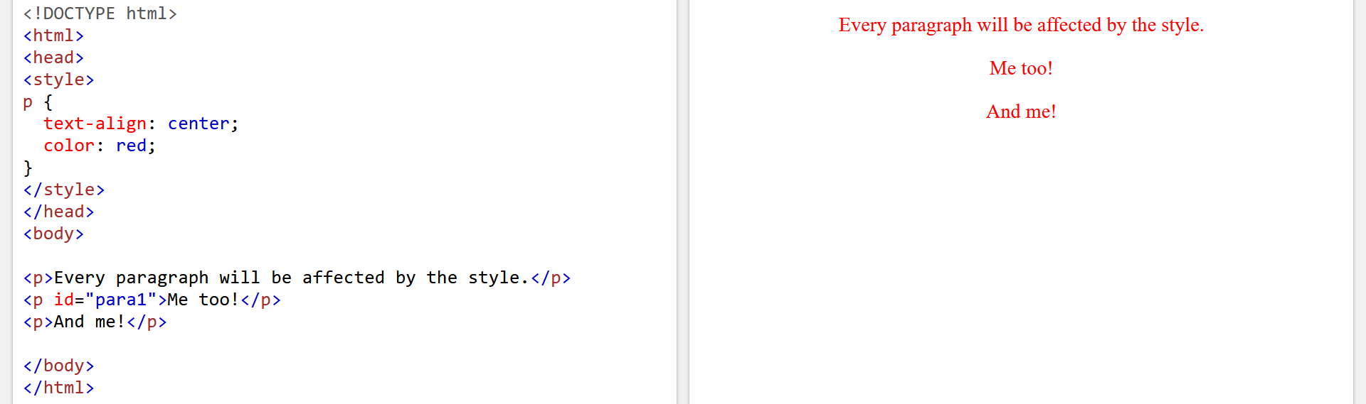
The CSS element Selector
The element selector selects HTML elements based on the element name.
Here, all <p> elements on the page will be center-aligned, with a red text color:

Slide 20
The CSS id Selector
The id selector uses the id attribute of an HTML element to select a specific element.
The id of an element is unique within a page, so the id selector is used to select one unique element!
To select an element with a specific id, write a hash (#) character, followed by the id of the element.

Slide 21
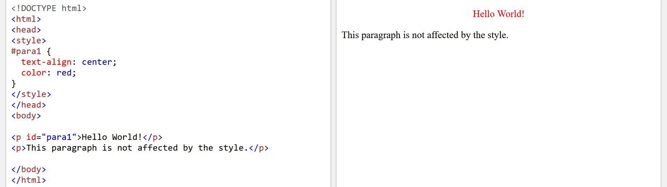


Slide 22
The CSS class Selector
The class selector selects HTML elements with a specific class attribute.
To select elements with a specific class, write a period (.) character, followed by the class name.

Slide 23
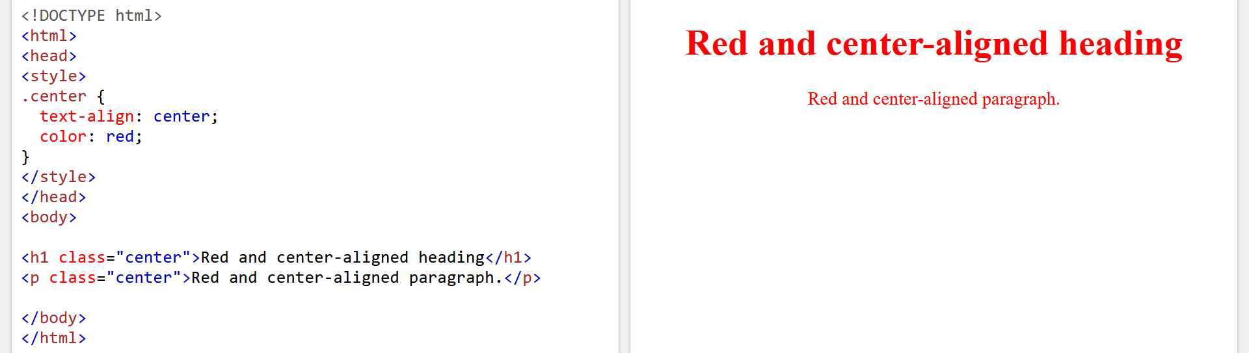

Slide 24
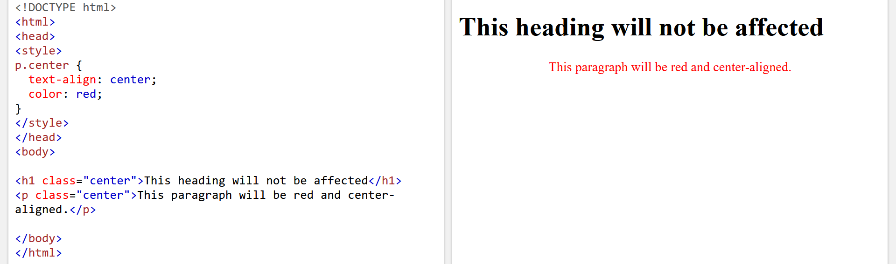

Slide 25
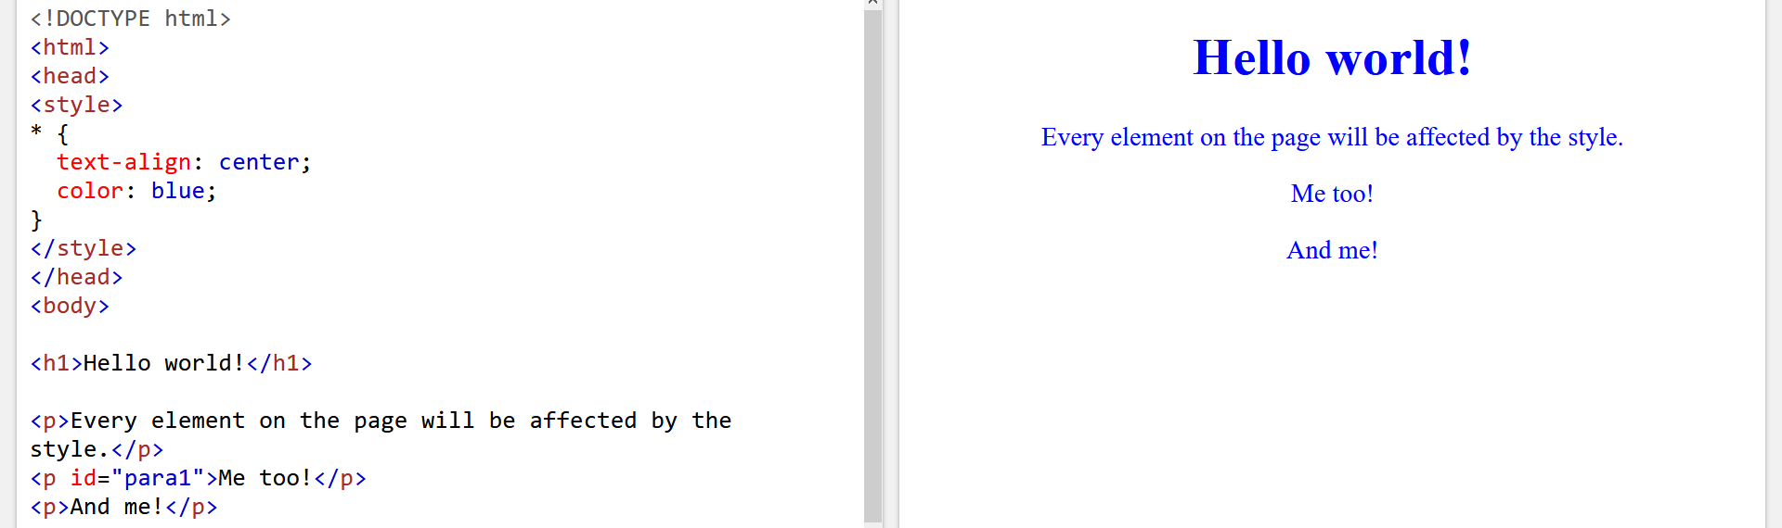
The CSS Universal Selector
The universal selector (*) selects all HTML elements on the page.

Slide 26
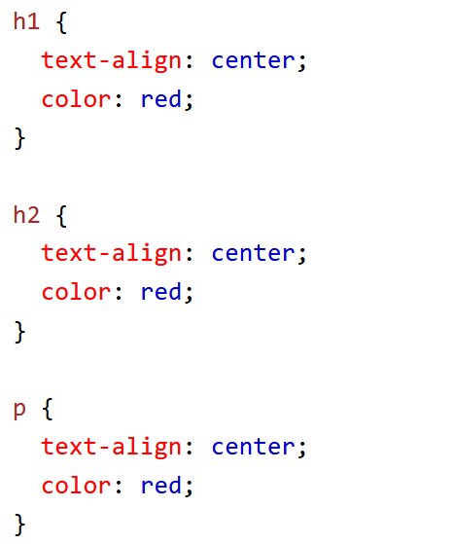
The CSS Grouping Selector
The grouping selector selects all the HTML elements with the same style definitions.
Look at the following CSS code (the h1, h2, and p elements have the same style definitions):

Slide 27
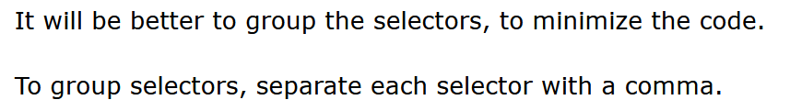
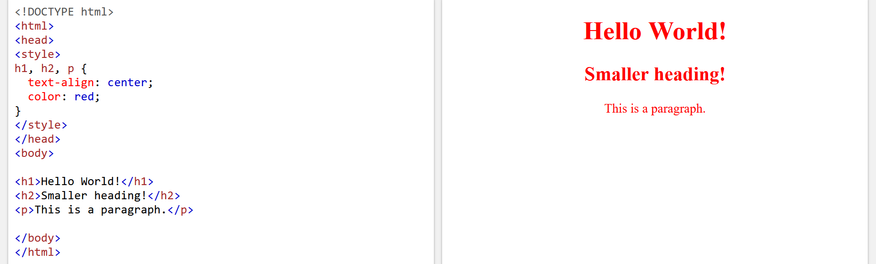

Slide 28
How To Add CSS

Slide 29
When a browser reads a style sheet, it will format the HTML document according to the information in the style sheet.

Slide 30
Three Ways to Insert CSS
There are three ways of inserting a style sheet:
External CSS
Internal CSS
Inline CSS

Slide 31
External CSS
With an external style sheet, you can change the look of an entire website by changing just one file!
Each HTML page must include a reference to the external style sheet file inside the <link> element, inside the head section

Slide 32
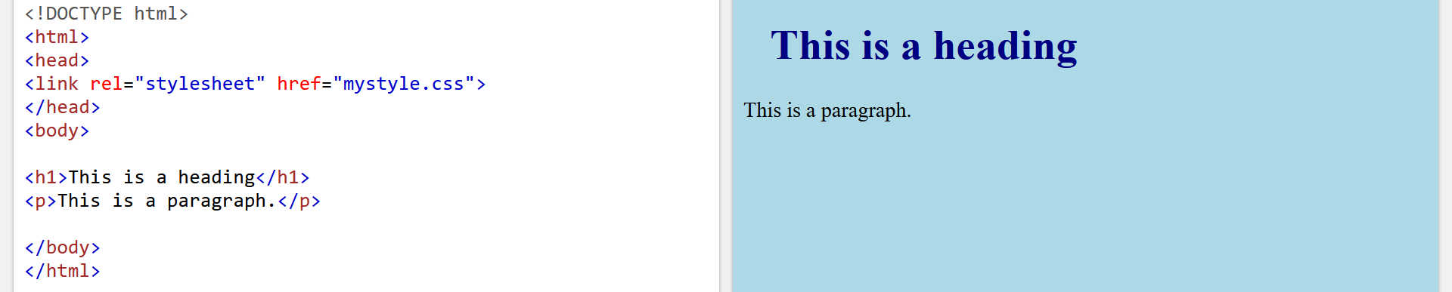

Slide 33
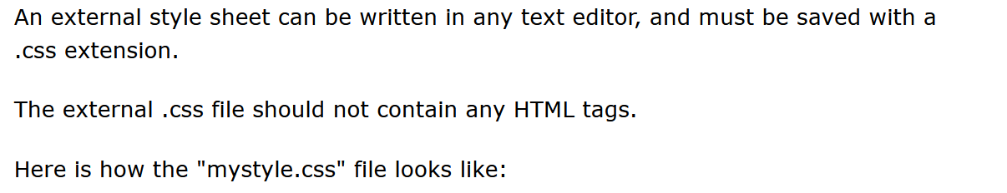
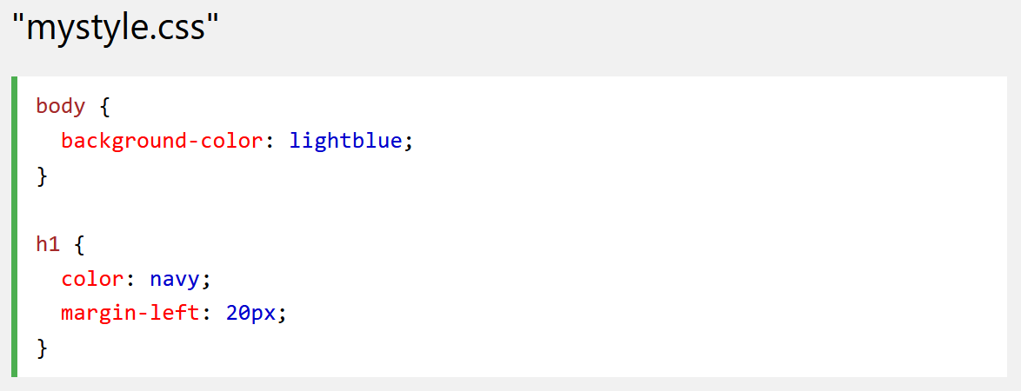
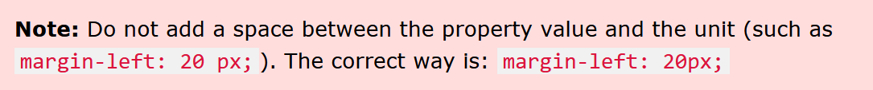

Slide 34
Internal CSS
An internal style sheet may be used if one single HTML page has a unique style.
The internal style is defined inside the <style> element, inside the head section.

Slide 35
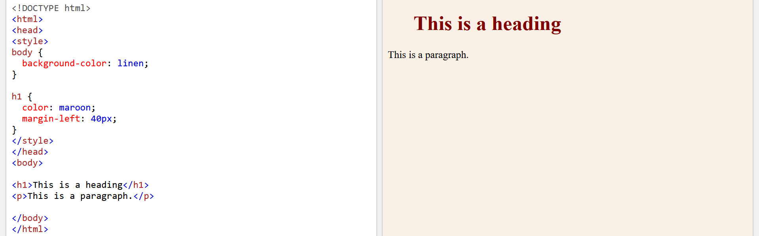

Slide 36
Inline CSS
An inline style may be used to apply a unique style for a single element.
To use inline styles, add the style attribute to the relevant element. The style attribute can contain any CSS property.

Slide 37
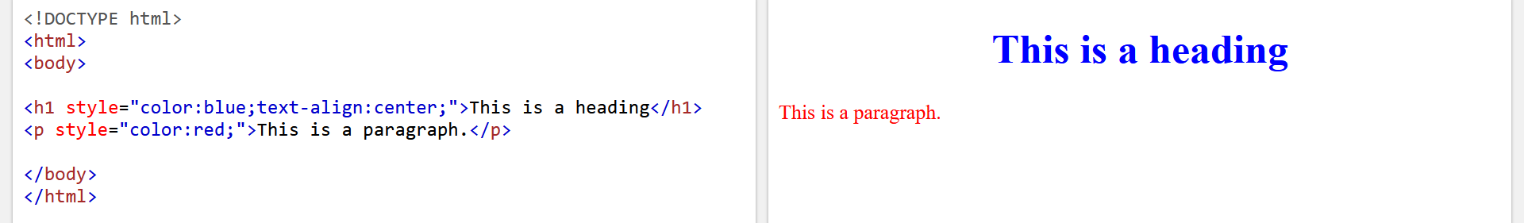

Slide 38
Multiple Style Sheets
If some properties have been defined for the same selector (element) in different style sheets, the value from the last read style sheet will be used.

Slide 39
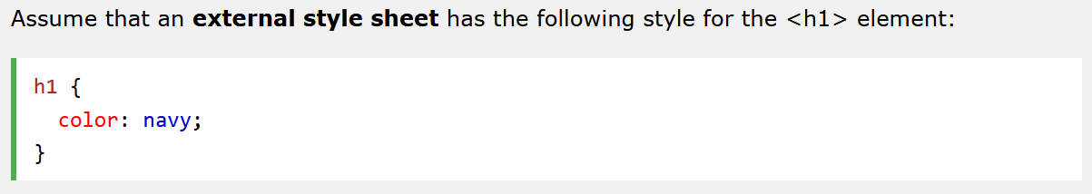
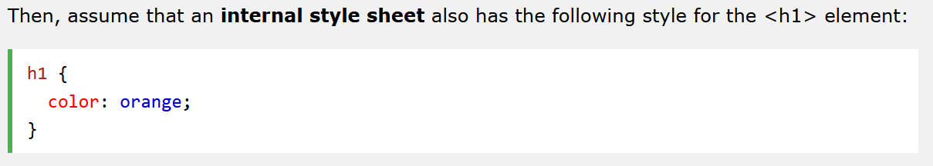

Slide 40
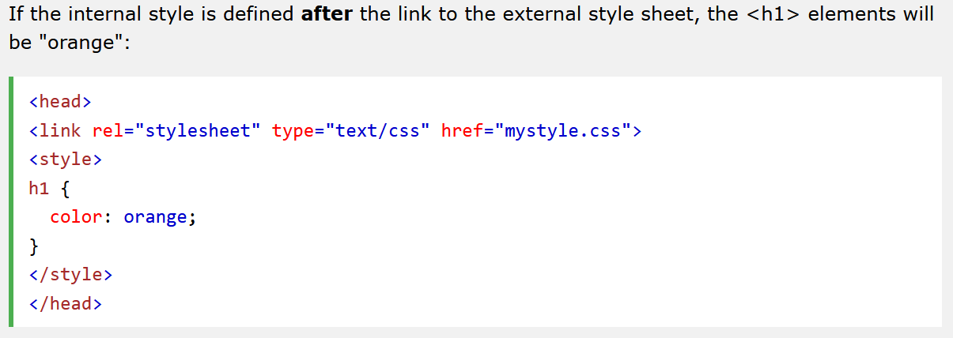

Slide 41
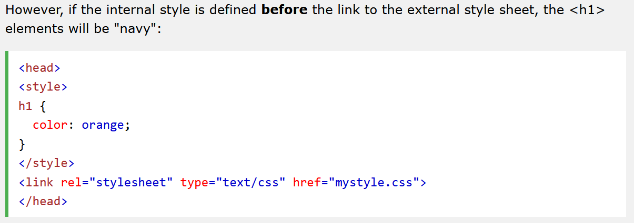

Slide 42
Cascading Order
What style will be used when there is more than one style specified for an HTML element?
All the styles in a page will "cascade" into a new "virtual" style sheet by the following rules, where number one has the highest priority:
Inline style (inside an HTML element)
External and internal style sheets (in the head section)
Browser default
So, an inline style has the highest priority, and will override external and internal styles and browser defaults.

Slide 43
CSS Comments

Slide 44
CSS Comments
Comments are used to explain the code, and may help when you edit the source code at a later date.
Comments are ignored by browsers.

Slide 45
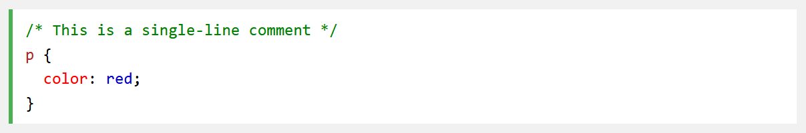
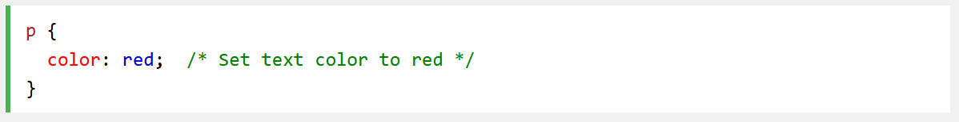
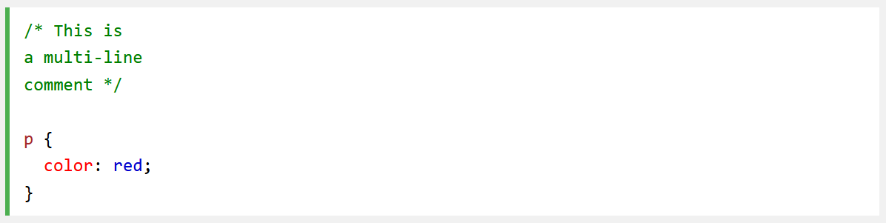

Slide 46
CSS Colors

Slide 47
CSS Colors
Colors are specified using predefined color names, or RGB, HEX, HSL, RGBA, HSLA values.
CSS/HTML support 140 standard color names.

Slide 48
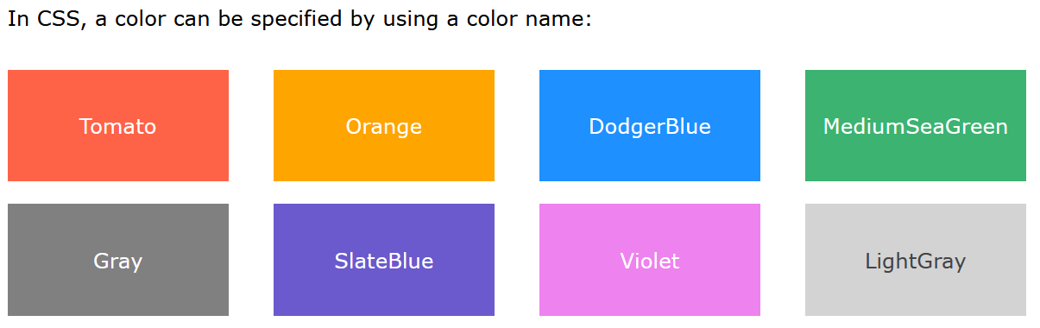
CSS Color Names

Slide 49
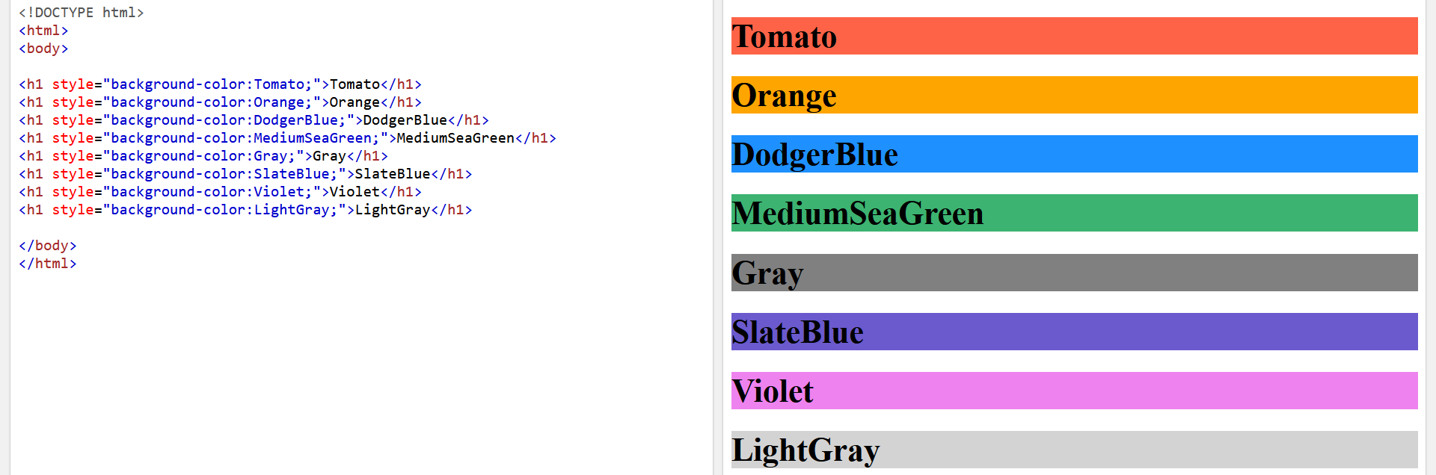

Slide 50
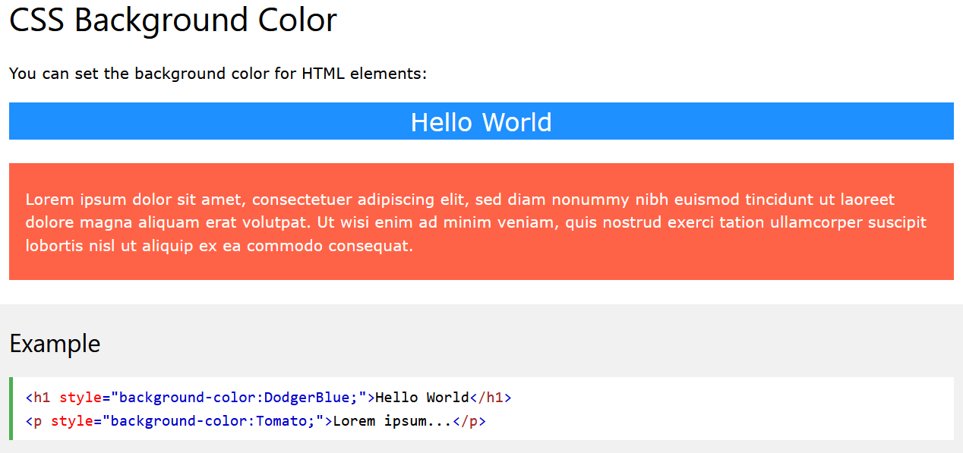

Slide 51
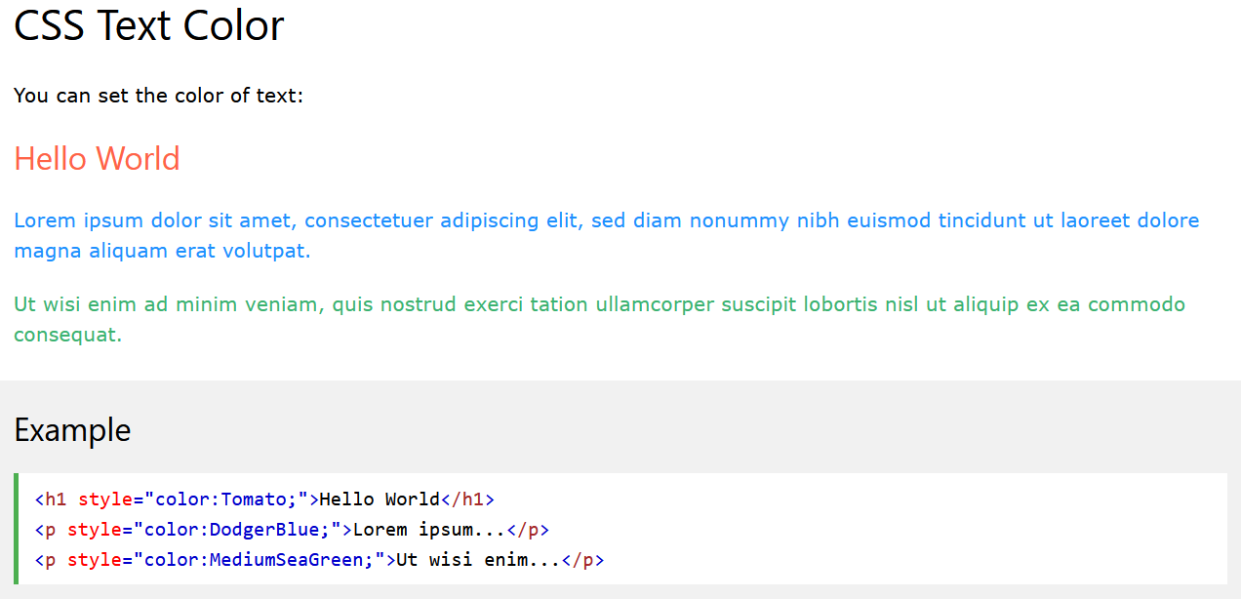

Slide 52
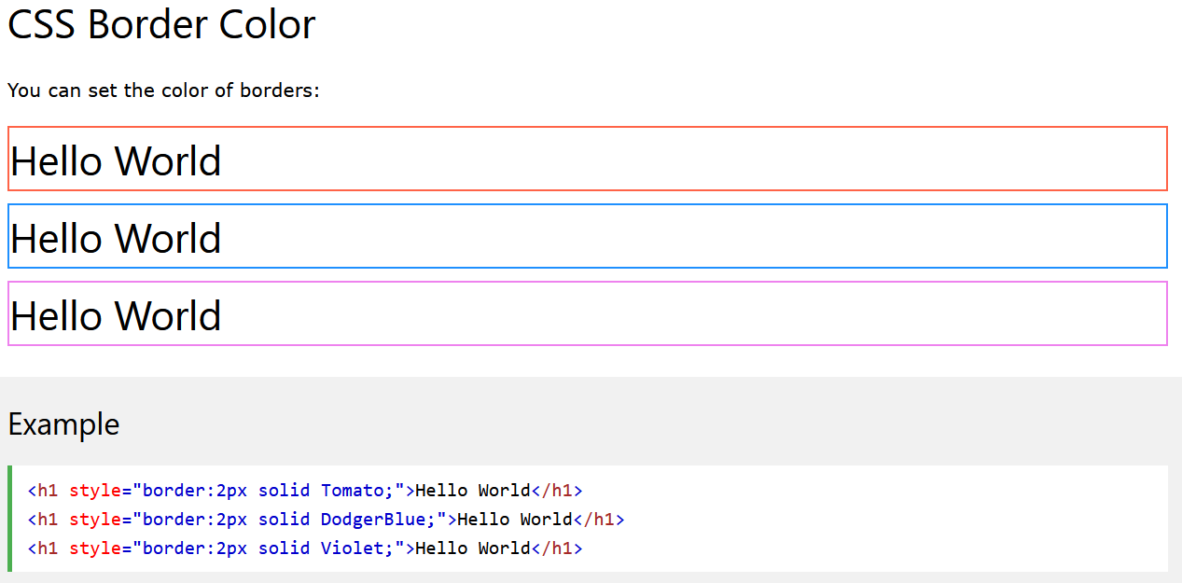

Slide 53
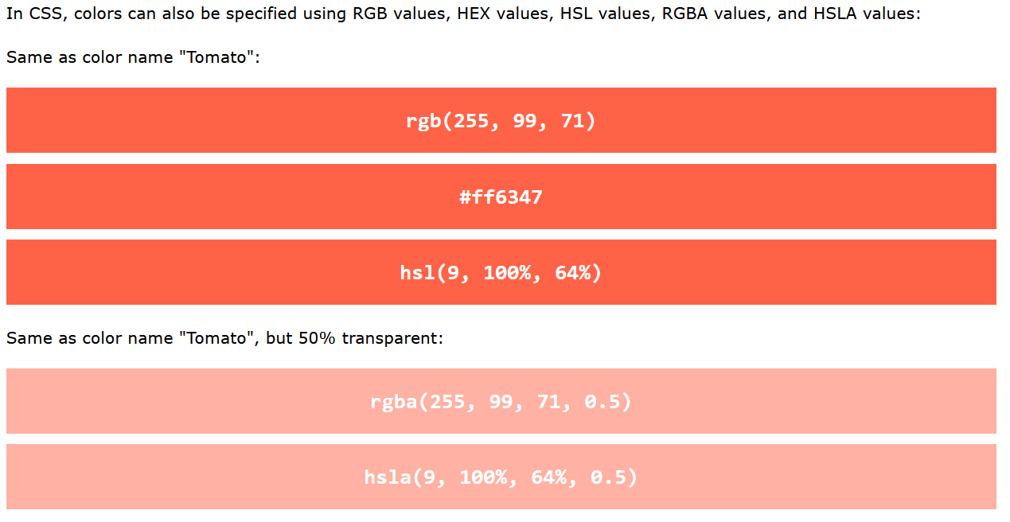
CSS Color Values

Slide 54
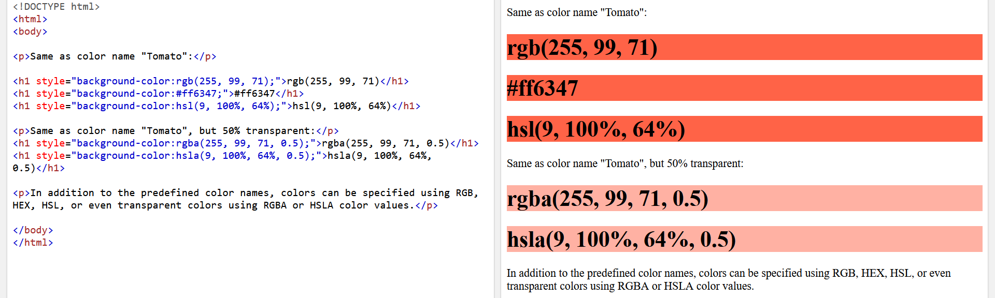

Slide 55
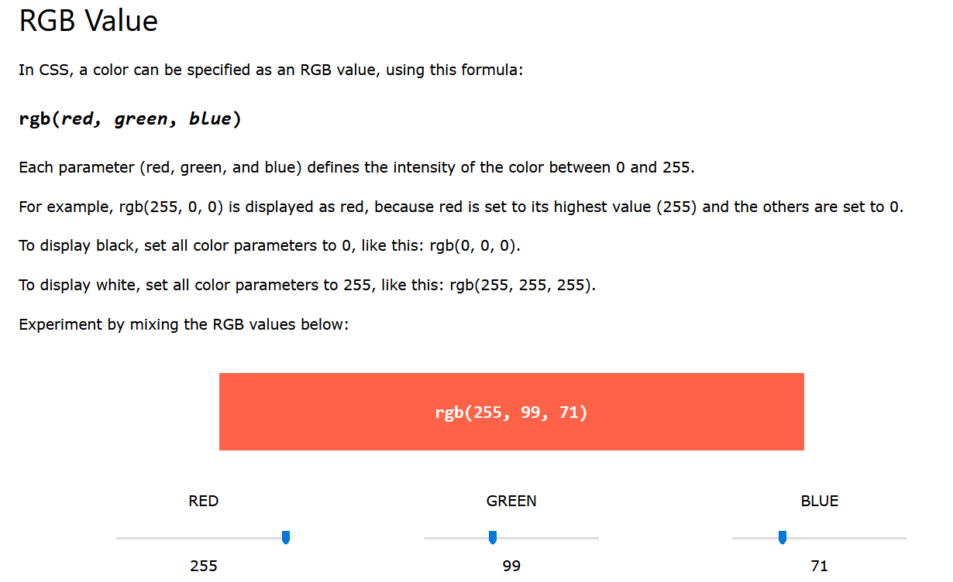
CSS RGB Colors

Slide 56
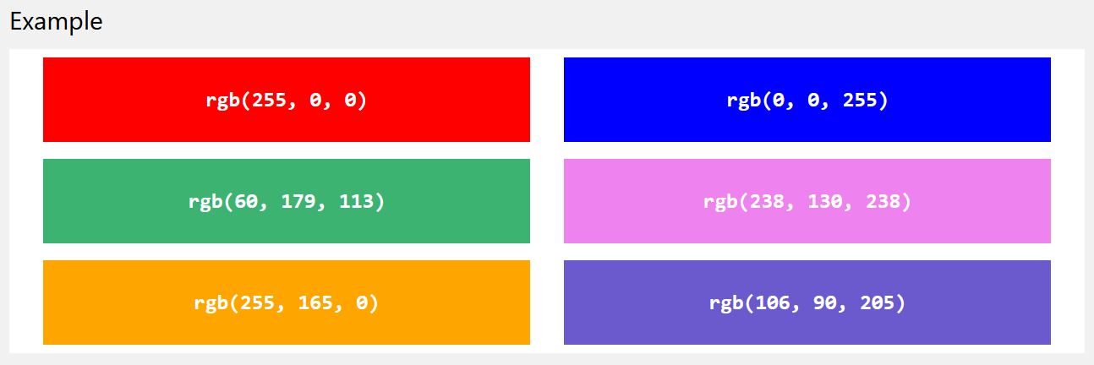

Slide 57
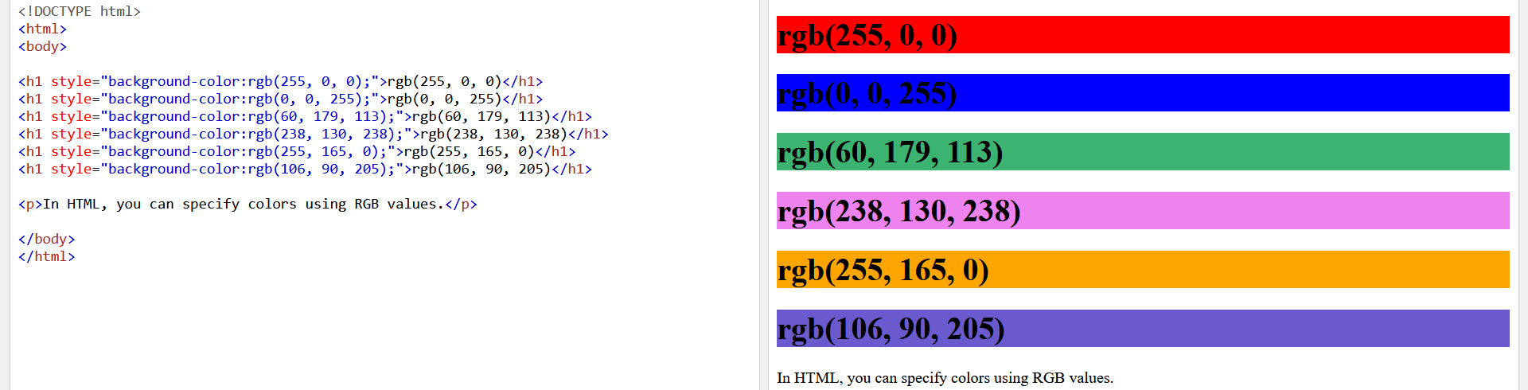

Slide 58
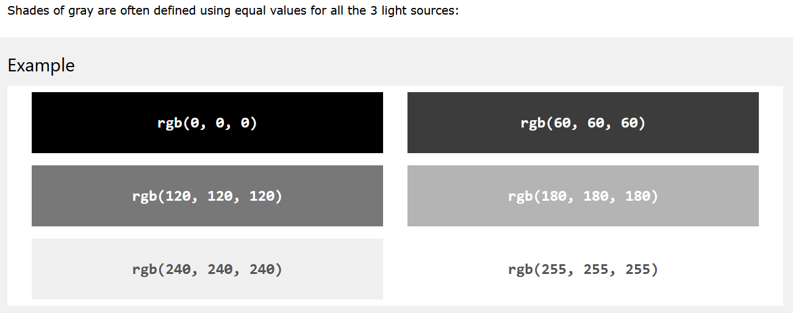

Slide 59
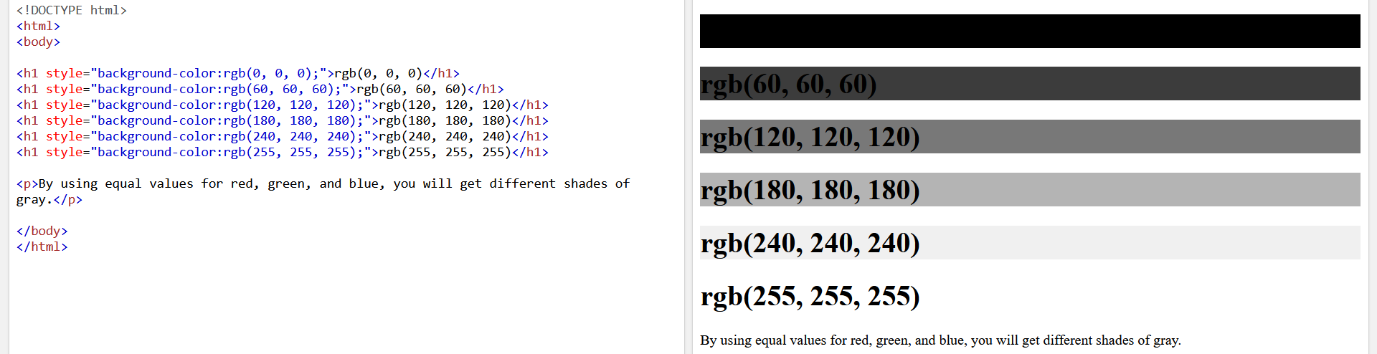

Slide 60
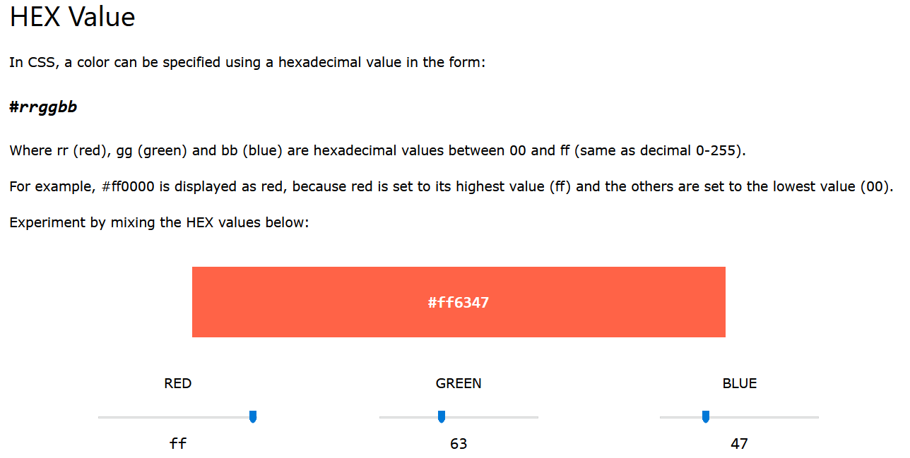
CSS HEX Colors

Slide 61


Slide 62
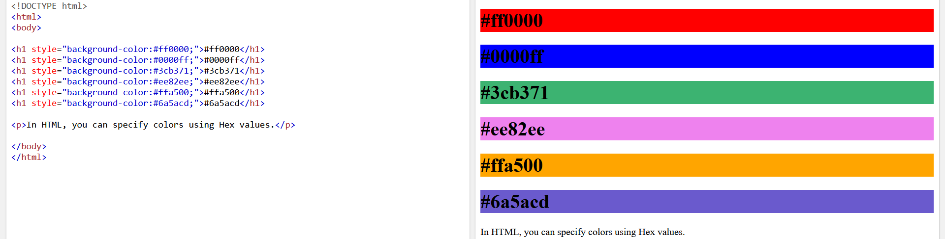

Slide 63
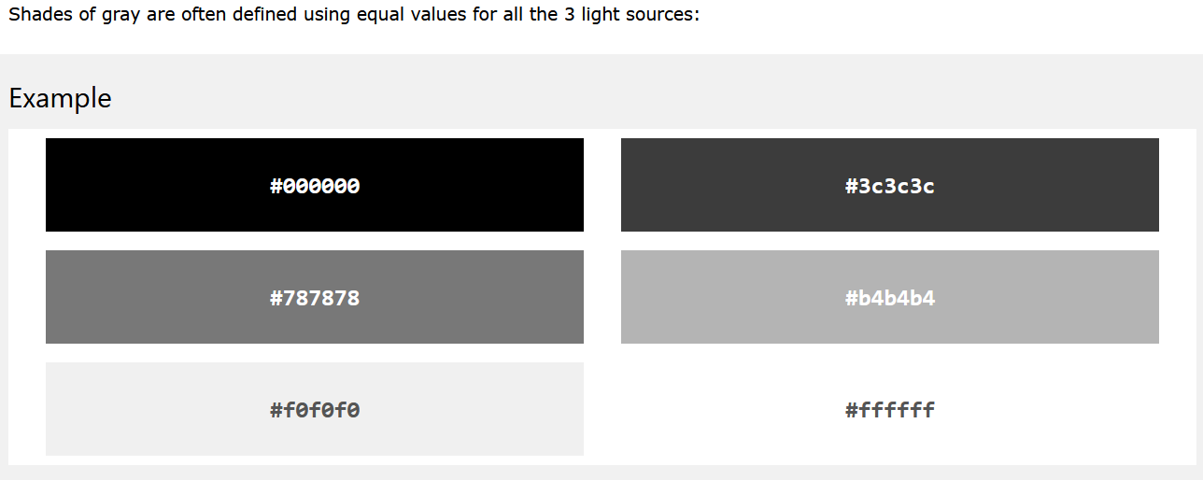

Slide 64
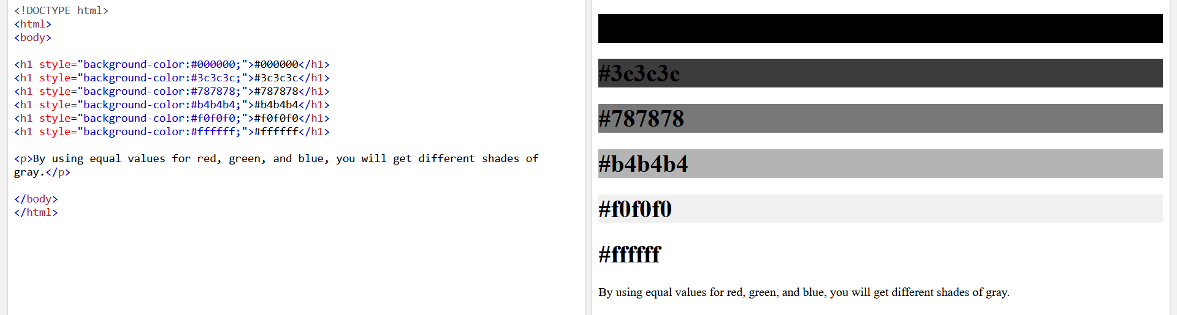

Slide 65
CSS Backgrounds

Slide 66
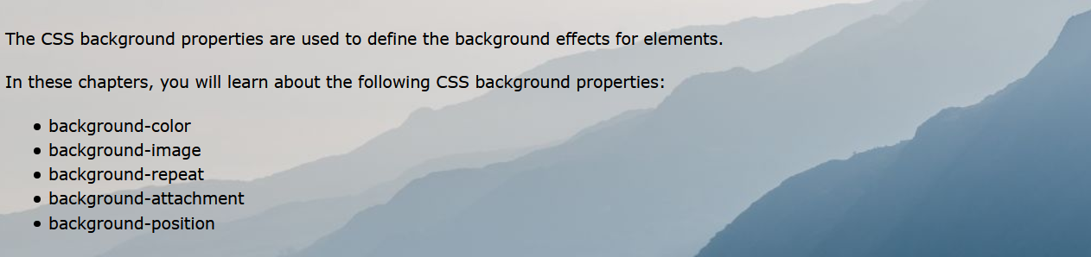

Slide 67
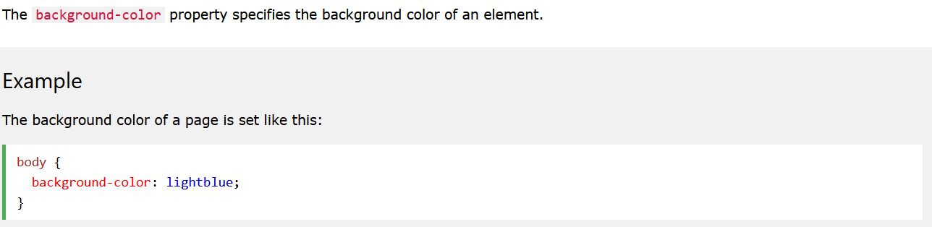
CSS background-color

Slide 68
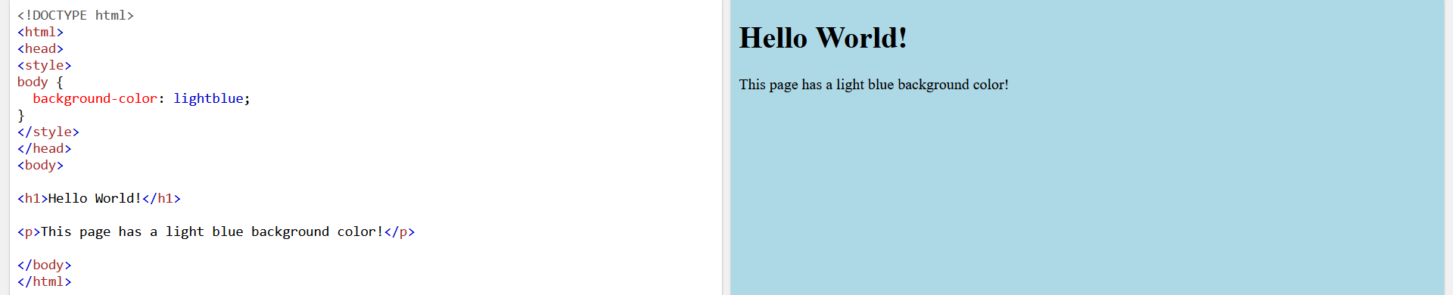

Slide 69
With CSS, a color is most often specified by:
a valid color name - like "red"
a HEX value - like "#ff0000"
an RGB value - like "rgb(255,0,0)"

Slide 70
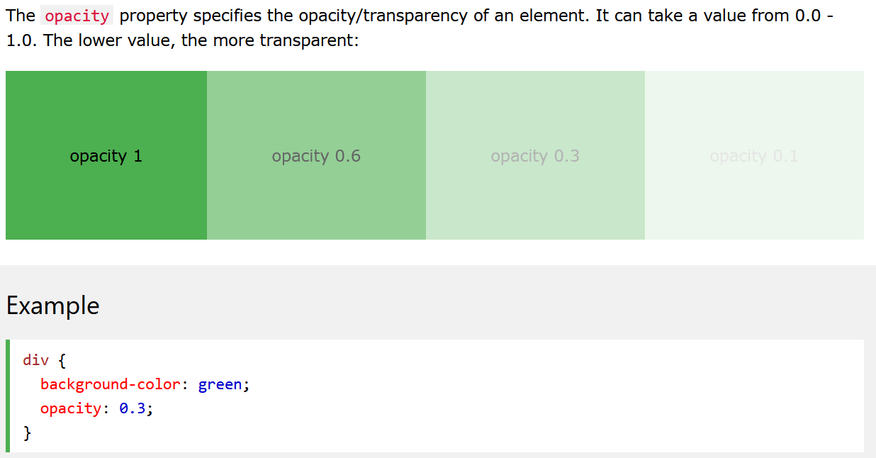
Opacity / Transparency

Slide 71
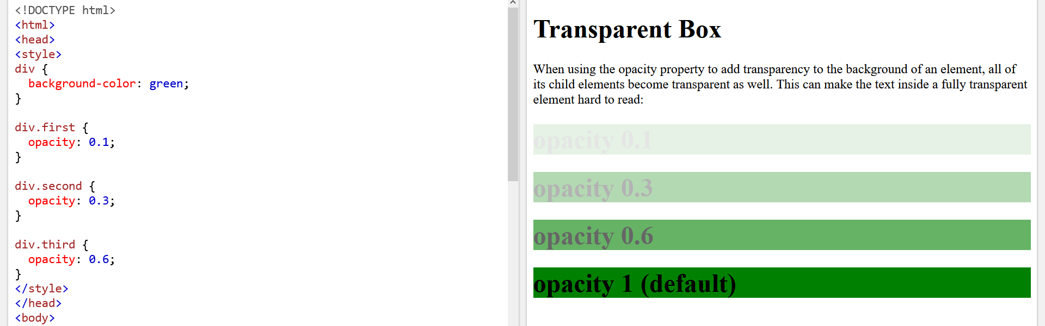

Slide 72
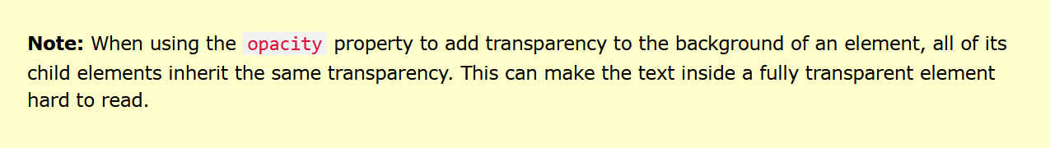

Slide 73
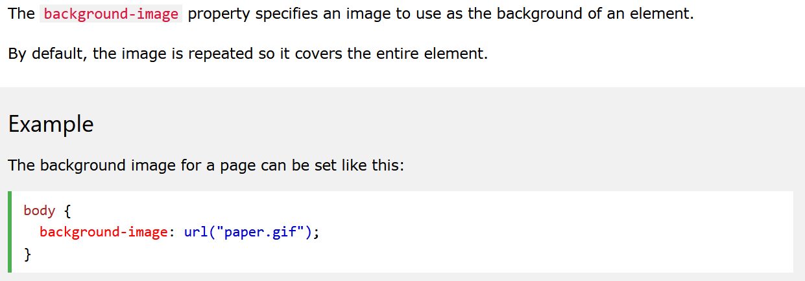
CSS background-image

Slide 74
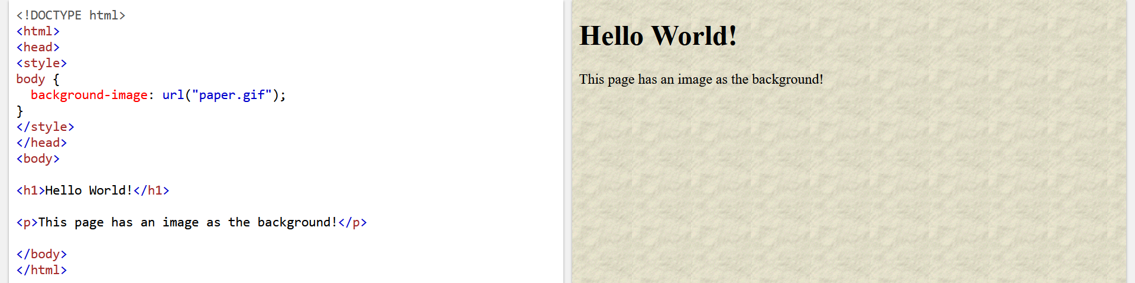

Slide 75


Slide 76


Slide 77


Slide 78

CSS background-repeat

Slide 79


Slide 80

https://www.w3schools.com/css/tryit.asp?filename=trycss_background-image_gradient2

Slide 82

CSS background-repeat: no-repeat

Slide 83

https://www.w3schools.com/css/tryit.asp?filename=trycss_background-image_norepeat

Slide 84

CSS background-position

Slide 85


Slide 86

CSS background-attachment
https://www.w3schools.com/css/tryit.asp?filename=trycss_background-image_attachment

Slide 87

https://www.w3schools.com/css/tryit.asp?filename=trycss_background-image_attachment2

Slide 88

CSS background - Shorthand property

Slide 89

https://www.w3schools.com/css/tryit.asp?filename=trycss_background_shorthand

Slide 90


Slide 91


Slide 92
CSS Fonts

Slide 93
The CSS font properties define the font family, boldness, size, and the style of a text.

Slide 94


Slide 95

CSS Font Families

Slide 97

Font Family

Slide 98


Slide 99


Slide 100

Font Style

Slide 101


Slide 102


Slide 103

Font Weight

Slide 104


Slide 105

Font Variant

Slide 106


Slide 107

Font Size

Slide 108


Slide 109

Set Font Size With Pixels

Slide 110


Slide 112

Set Font Size With Em

Slide 113


Slide 114


Slide 115

Responsive Font Size

Slide 116

https://www.w3schools.com/css/tryit.asp?filename=trycss_font_responsive

Slide 117


Slide 118


Google Fonts

Slide 119

CSS Font - Shorthand Property

Slide 120

https://www.w3schools.com/css/tryit.asp?filename=trycss_font

Slide 122
CSS Text

Slide 123


Slide 124

Text Color

Slide 125


Slide 126


Slide 127

Text Color and Background Color

Slide 128


Text Alignment

Slide 129


Slide 130


Slide 131


Slide 132


Vertical Alignment

Slide 133


Slide 134

Text Decoration

Slide 135


Slide 136


Slide 137


Text Transformation

Slide 138

CSS Text Shadow

Slide 139


Slide 140


Slide 141
CSS Borders

Slide 142

CSS Shorthand Border Property

Slide 143


Slide 144
CSS Margins

Slide 145


Slide 146

CSS Margins

Slide 147

Margin - Shorthand Property

Slide 148


Slide 149


Slide 150
CSS Padding

Slide 151


Slide 152
CSS Padding

Slide 153

Padding - Shorthand Property

Slide 154


Slide 155


Slide 156

Padding and Element Width

Slide 157


Slide 158


Slide 159

https://www.w3schools.com/css/tryit.asp?filename=trycss_padding_width2

Slide 160
CSS Box Model

Slide 161


The CSS Box Model

Slide 162


Slide 163


Slide 164
CSS Frameworks

Slide 165
What is CSS Framework?
CSS frameworks provide a basic structure for designing consistent solutions to tackle common recurring issues across front end web development.
This greatly decreases the time needed to start creating applications and websites.

Slide 166
What is CSS Framework? (cont.)
This way developers do not have to start from scratch every time when building applications.
They can reuse the foundation from earlier applications and get straight into working on the website or application rather than coding in every little details again for each application.

Slide 167
10 Best CSS Frameworks for Front-End Developers
Bootstrap
Foundation
Bulma
Ulkit
Semantic UI
Susy
Materialize
Pure
Skeleton
Milligram
Reference: https://geekflare.com/best-css-frameworks/

Slide 168

Bootstrap

Slide 169

https://getbootstrap.com/

Slide 170
Thank You ☺ Luis Daniel A. Pambid Fb: pambsdaniel Instagram: pambsdaniel

Slide 171


Slide 172
vertical-align: middle;
display: inline;
color: white;
background-color: blue;
width: 500px;
margin: auto;
border: 2px solid black;
font-family: arial;
text-align: center;
font-variant: small-caps;
background-color: white;
color: black;
background-color: tomato;
background-color: black;
color: white;
border: 2px solid black;
border-radius: 25px;

Slide 173


Slide 174
width: 500px;
margin: auto;
text-align: center;
text-align: center;
fony-family: arial;
color: black;
font-family: arial;

